Slide 1

TOPIC:
Computer Organization and Architecture
Introduction to Input-Output Interface
By
Dr. Ashish Kumar Singh

Slide 2
Input-Output Interface
Input-Output Interface is used as an method which helps in transferring of information between the internal storage devices i.e. memory and the external peripheral device . A peripheral device is that which provide input and output for the computer, it is also called Input-Output devices.
For Example: A keyboard and mouse provide Input to the computer are called input devices while a monitor and printer that provide output to the computer are called output devices. Just like the external hard-drives, there is also availability of some peripheral devices which are able to provide both input and output.

Slide 3
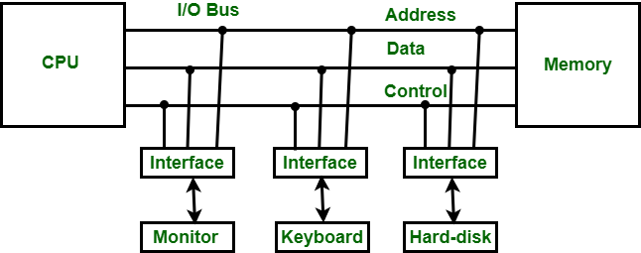
Input-Output Interface

Slide 4
In micro-computer base system, the only purpose of peripheral devices is just to provide special communication links for the interfacing them with the CPU. To resolve the differences between peripheral devices and CPU, there is a special need for communication links.
The major differences are as follows:
The nature of peripheral devices is electromagnetic and electro-mechanical. The nature of the CPU is electronic. There is a lot of difference in the mode of operation of both peripheral devices and CPU.
There is also a synchronization mechanism because the data transfer rate of peripheral devices are slow than CPU.
In peripheral devices, data code and formats are differ from the format in the CPU and memory.
The operating mode of peripheral devices are different and each may be controlled so as not to disturb the operation of other peripheral devices connected to CPU.
There is a special need of the additional hardware to resolve the differences between CPU and peripheral devices to supervise and synchronize all input and output devices.

Slide 5
Functions of Input-Output Interface:
It is used to synchronize the operating speed of CPU with respect to input-output devices.
It selects the input-output device which is appropriate for the interpretation of the input-output device.
It is capable of providing signals like control and timing signals.
In this data buffering can be possible through data bus.
There are various error detectors.
It converts serial data into parallel data and vice-versa.
It also convert digital data into analog signal and vice-versa.

Slide 6
Thank You !!!

